Slide 1
Computer Networks
“REFERENCE MODELS”
Asst. Lect. Ahmed M. Jasim
Computer Department - College of Engineering
University of Diyala
2017

Slide 2
Presentation Outline
Advantages of Reference Models
OSI reference model.
TCP/IP reference model.
Data Encapsulation

Slide 3
Advantages of Reference Models
1- It divides the network communication process into smaller and simpler components, thus aiding component development, design, and troubleshooting.
2- It allows multiple-vendor development through standardization of network components.

Slide 4
Advantages of Reference Models
3- It encourages industry standardization by defining what functions occur at each layer of the model.
4- It allows various types of network hardware and software to communicate.
5- It prevents changes in one layer from affecting other layers, so it doesn’t hamper development and makes application programming easier.

Slide 5
OSI reference model
In the late 1970s, the Open Systems Interconnection (OSI) reference model was created by the International Standards Organization
The OSI model was meant to help vendors create interoperable network devices and software in the form of protocols so that different vendor networks could work with each other
The ISO-OSI model is a seven-layers architecture.

Slide 6
OSI reference model
One of the greatest functions of the OSI specifications is to assist in data transfer between disparate hosts
The OSI model isn’t a physical model. Rather, it’s a set of guidelines that application developers can use to create and implement applications that run on a network.
It also provides a framework for creating and implementing networking standards, devices, and internetworking schemes.

Slide 7
OSI reference model
Layer 7 | Application | Application services
Layer 6 | Presentation | Data encryption, compression, translation services
Layer 5 | Session | Dialog control
Layer 4 | Transport | End-to-end connection
Layer 3 | Network | Routing
Layer 2 | Data Link | Framing
Layer 1 | Physical | Physical topology

Slide 8
OSI reference model
1- Application layer
HTTP (Hyper Text Transfer Protocol), file transfer, electronic mail, and network news.
Functions of application layer
1- Mail Services
2- Network Virtual Terminal
3- Directory Services
4= File Transfer, Access and Management (FTAM):

Slide 9
OSI reference model
2- Presentation Layer
The primary goal of this layer is to take care of the syntax and semantics of the information exchanged between two communicating systems
Functions of presentation layer:
1- Translation
2- Encryption
3- Compression

Slide 10
OSI reference model
3- Session Layer
Its main aim is to establish, maintain and synchronize the interaction between communicating systems
Functions of session layer:
1- Dialog Control: This layer allows two systems to start communication with each other in half-duplex or full-duplex.
2- Synchronization: This layer allows a process to add checkpoints which are considered as synchronization points into stream of data

Slide 11
OSI reference model
4- Transport Layer
The main aim of transport layer is to be delivered the entire message from source to destination.
Functions of transport layer:
1- Service Point Addressing
2- Segmentation and Reassembling
3- Connection Control
4- Flow Control
5- Error Control

Slide 12
OSI reference model
5- Network Layer
The main aim of this layer is to deliver packets from source to destination across multiple links (networks).
Functions of network layer:
1- Routing
Static
Dynamic
Semi-Dynamic
2- Congestion Control
3- Internetworking: Internetworking is a solution born of three networking problems:
Isolated LANs
Duplication of resources
The lack of a centralized network management system.

Slide 13
OSI reference model
6- Data Link layer
Data link layer is most reliable node to node delivery of data
Functions of network layer:
1- Framing
2- Acknowledgment
3- Sequence Numbering
4- Error Detection
5- Retransmission
6- Flow Control

Slide 14
OSI reference model
7- Physical Layer
The physical layer is concerned with transmitting raw bits over a communication channel.
The design issues have to do with making sure that when one side sends a 1 bit it is received by the other side as a 1 bit, not as a 0 bit. It defines the hardware, cabling, wiring, power output, pulse rate etc.
Functions of physical layer:
1- Hardware Specification
2- Encoding and Signaling
3- Data Transmission and Reception
4- Topology and Network Design

Slide 15
TCP/IP reference model
TCP/IP means Transmission Control Protocol and Internet Protocol.
It is the network model used in the current Internet architecture as well.
Protocols are set of rules which govern every possible communication over a network.
The TCP/IP model is basically a condensed version of the OSI model — it’s composed of four, instead of seven, layers
TCP/IP was developed by Department of Defence's Project Research Agency (ARPA, later DARPA) as a part of a research project of network interconnection to connect remote machines.

Slide 16
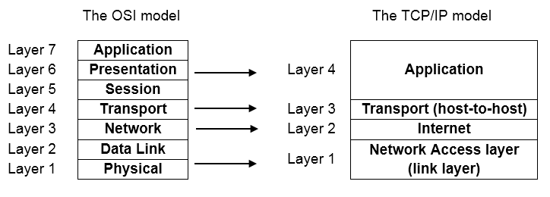
TCP/IP reference model

Slide 17
TCP/IP reference model
The features that stood out during the research, which led to making the TCP/IP reference model were:
Support for a flexible architecture.
The network was robust

Slide 18
TCP/IP reference model
1- Application layer
A vast array of protocols combines at the Application layer
The Application layer defines protocols for node-to-node application communication
Controls user-interface specifications.

Slide 19
TCP/IP reference model
2- The Transport (Host-to-Host) layer
Two end-to-end transport protocols have been defined here.
1- TCP (Transmission Control Protocol)
Reliable connection-oriented protocol
Segments the incoming byte stream
Reassembles the received messages
Flow control
2- UDP (User Datagram Protocol),
An unreliable, connectionless protocol
It is also widely used for one-shot, client-server-type request-reply queries

Slide 20
TCP/IP reference model
3- The Internet layer
The internet layer defines an official packet format and protocol called IP
Plus a companion protocol called ICMP
The job of the internet layer is to deliver IP packets where they are supposed to go.
Packet routing is clearly a major issue here.

Slide 21
TCP/IP reference model
4- The Network Access layer
The Network Access layer monitors the data exchange between the host and the network.
Oversees hardware addressing
Defines protocols for the physical transmission of data.

Slide 22
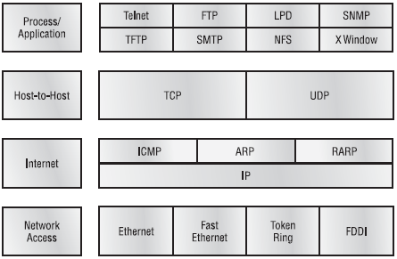
TCP/IP reference model

Slide 23
The Model Used in in our course
The strength of the OSI reference model is the model itself
The strength of the TCP/IP reference model is the protocols.
The Model Used in our course has five layers.

Slide 24
The Model Used in in our course
Layer 5 | Application
Layer 4 | Transport
Layer 3 | Network
Layer 2 | Link
Layer 1 | Physical

Slide 25
The Model Used in in our course
The physical layer
How to transmit bits across different kinds of media as electrical (or other analog) signals.
The link layer
How to send finite-length messages between directly connected computers with specified levels of reliability.
Ethernet and 802.11 (Wi-Fi) are examples of link layer protocols.

Slide 26
The Model Used in in our course
The network layer
How to combine multiple links into networks.
Finding the path along which to send the packets.
IP is the main example.
The transport layer
Strengthens the delivery guarantees of the Network layer
Increased reliability
TCP is an important example.

Slide 27
The Model Used in in our course
5- The application layer
Contains programs that make use of the network.
HTTP and DNS are used by many applications.

Slide 28
Comparison of OSI and TCP/IP
No. | OSI (Open System Interconnection) | TCP/IP (Transmission Control Protocol / Internet Protocol)
1 | OSI is a generic, protocol independent standard, acting as a communication gateway between the network and end user. | TCP/IP model is based on standard protocols around which the Internet has developed. It is a communication protocol, which allows connection of hosts over a network.
2 | In OSI model the transport layer guarantees the delivery of packets. | In TCP/IP model the transport layer does not guarantee delivery of packets. Still the TCP/IP model is more reliable.
3 | OSI model has a separate Presentation layer and Session layer. | TCP/IP does not have a separate Presentation layer or Session layer.

Slide 29
Comparison of OSI and TCP/IP
No. | OSI (Open System Interconnection) | TCP/IP (Transmission Control Protocol / Internet Protocol)
4 | OSI is a reference model around which the networks are built. Generally it is used as a guidance tool. | TCP/IP model is, in a way implementation of the OSI model.
5 | Network layer of OSI model provides both connection oriented and connectionless service | The Network layer in TCP/IP model provides connectionless service.
6 | OSI model has a problem of fitting the protocols into the model. | TCP/IP model does not fit any protocol

Slide 30
Comparison of OSI and TCP/IP
No. | OSI (Open System Interconnection) | TCP/IP (Transmission Control Protocol / Internet Protocol)
7 | Protocols are hidden in OSI model and are easily replaced as the technology changes. | In TCP/IP replacing protocol is not easy.
8 | OSI model defines services, interfaces and protocols very clearly and makes clear distinction between them. It is protocol independent. | In TCP/IP, services, interfaces and protocols are not clearly separated. It is also protocol dependent.
9 | It has 7 layers | It has 4 layers

Slide 31
Data Encapsulation
When a host transmits data across a network to another device, the data goes through a process called encapsulation and is wrapped with protocol information at each layer of the OSI or TCP/IP model. Each layer communicates only with its peer layer on the receiving device.

Slide 32
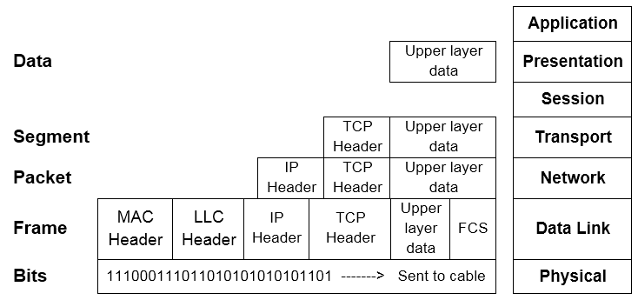
Data Encapsulation

Slide 33
Data Encapsulation
At a transmitting device, the data encapsulation method works like this:
1- User information is converted to data for transmission on the network.
2- Data is converted to segments, and a reliable connection is set up between the transmitting and receiving hosts.
3- Segments are converted to packets or datagrams, and a logical address is placed in the header so each packet can be routed through an internetwork.
4- Packets or datagrams are converted to frames for transmission on the local network. Hardware (Ethernet) addresses are used to uniquely identify hosts on a local network segment.
5- Frames are converted to bits, and a digital encoding and clocking scheme is used.

Slide 34
THANK YOU

